Slide 2
WHY MATRIX KEYPAD?
Typically one port pin is required to read a button.
When there are a lot of button that has to be read, it is not feasible to allocate one pin for each of them.
This is when a matrix keypad arrangement is used to reduce the pin count.

Slide 3
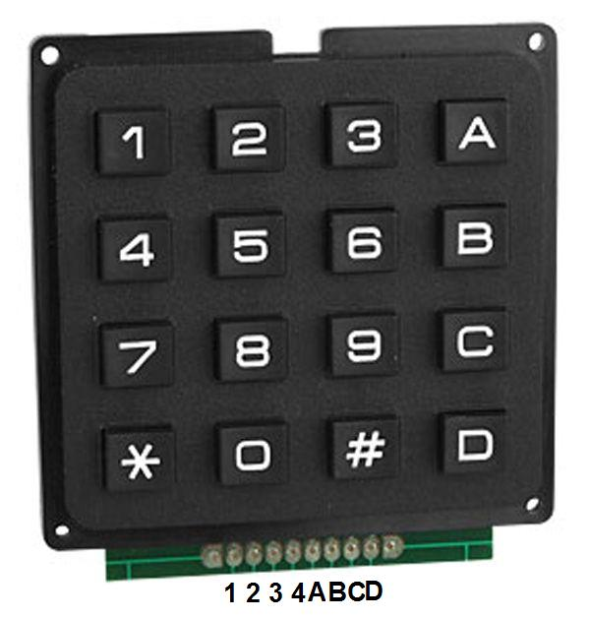

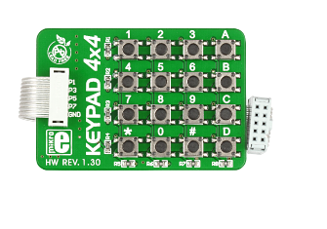
KEYPAD 4x4

Slide 4
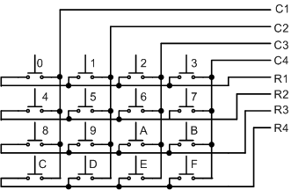
KEYPAD 4x4

Slide 5
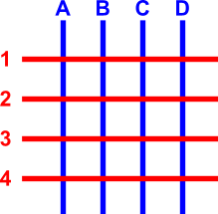
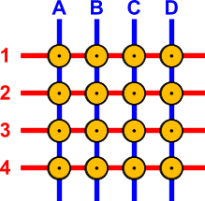
HOW TO MAKE A KEYPAD 4X4?
The blue lines are the columns and the red lines the rows.
The columns and the rows are NOT in contact! Suppose that we want to make a key matrix. To do this, we will have to connect a button to each knot.
The buttons will have a push-to-make contact. When the operator pushes this button, it will connect the column and the row that it corresponds to.

Slide 6
KEYPAD 4X4 SCAN ALGORITHM

Slide 7
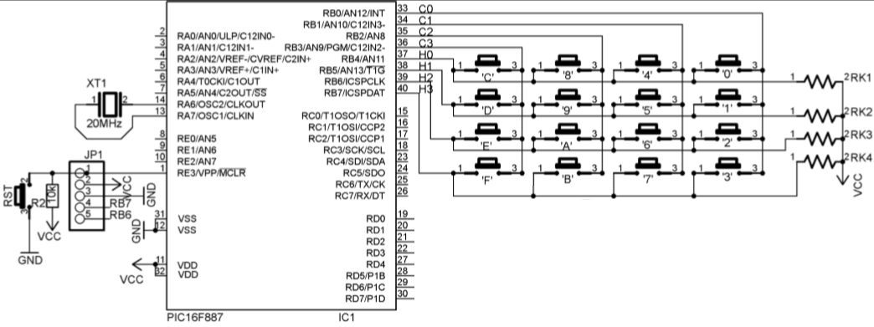
SCHEMATIC

Slide 8
EXAMPLE
Scan matrix keypad 4x4 and display the code of pressed key on one anode common 7 segment led.

Slide 9
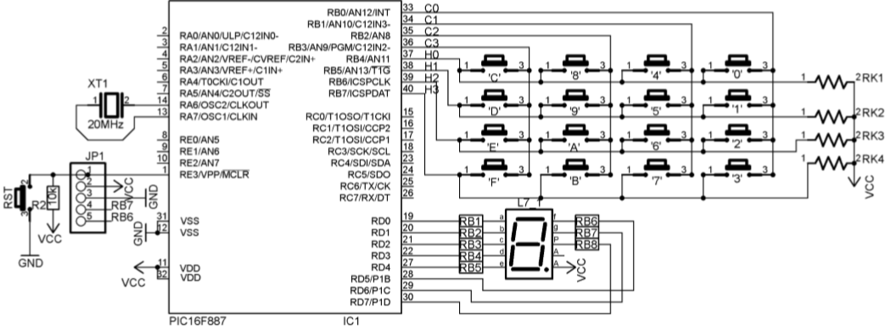
SCHEMATIC

Slide 10
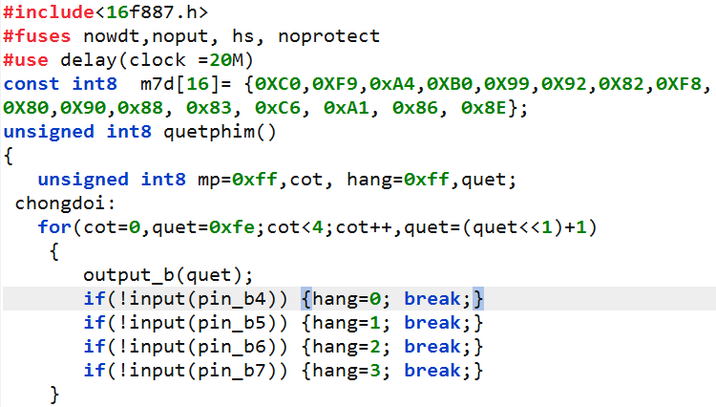
CODE

Slide 11
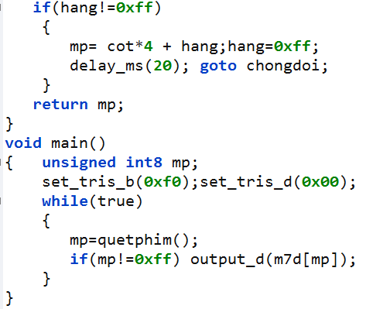
CODE

Slide 12
Test the theory by simulink

Slide 13
Thank You !

